Slide 1

Cross site scripting
Prepared By : Komalkumari SIngh

Slide 2
CROSS SITE SCRIPTING
Domain :
Vulnweb.com
SUBDOMAIN :
Testasp.vulnweb.com

Slide 3
STEPS TO REPRODUCE
Visit http://testasp.vulnweb.com/
On the top menu you will find a search option.
Click on it and you will be prompted with the search box.
You can intercept the request in Burp suite.
Now you can find different payloads for xss.
Send the Request to intruder and paste all the payloads.
Try to find a successful payload for xss.
Prepare a report for it.

Slide 4
Key Impacts of XSS:
Session Hijacking: Attackers can steal session cookies and impersonate the victim, gaining unauthorized access to their account on the web application.
Data Theft: XSS can capture sensitive information like usernames, passwords, or financial data entered by users, which can then be sent to the attacker.
Phishing and Social Engineering: Attackers can craft fake forms or messages, tricking users into entering credentials or other confidential information, believing it’s legitimate.
Defacement:Malicious scripts can alter the content of the website as viewed by the user, displaying fake or harmful content.
Malware Distribution: XSS can be used to spread malware, causing the victim's browser to download malicious files or redirect to malicious websites.
Reputation Damage: If users perceive a site as insecure, they may lose trust in the organization, affecting its reputation and user engagement.

Slide 5

MITIGATION OF CROSS SITE SCRIPTING
Mitigating Cross-Site Scripting (XSS) involves a combination of secure coding practices, proper input validation, output encoding, and security policies

Slide 6
KEY STRATEGIES OF XSS
Input Validation:
Sanitize Input: Filter out or sanitize user inputs that could contain malicious scripts before processing.
Whitelist Input:Allow only safe characters and expected data formats, especially for input fields where only specific data is expected (e.g., numbers in a phone number field).
Content Security Policy (CSP):
Set a Strict CSP: Content Security Policy restricts sources of scripts, styles, and other content types that can load on your website. A well-configured CSP can prevent malicious scripts from executing even if they make it onto the page.
Avoid Inline JavaScript:
Place all JavaScript in external files or at the end of the HTML page to reduce exposure to XSS attacks. This makes it easier to control and audit JavaScript code and implement CSP.
Use Security Libraries and Frameworks:
Many web frameworks offer templating engines that automatically escape potentially harmful characters (e.g., Django, Flask’s Jinja2, etc.).
Educate Developers:
Training on secure coding practices, especially around handling user input and output encoding, is critical in preventing XSS vulnerabilities during development.

Slide 7
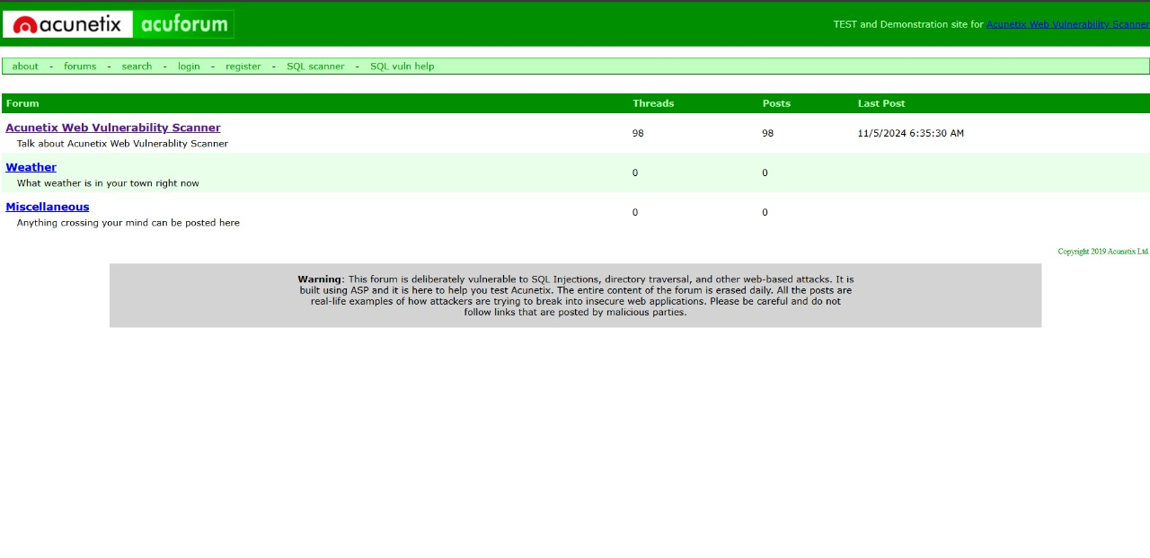
VISITING THE WEBSITE

Slide 8
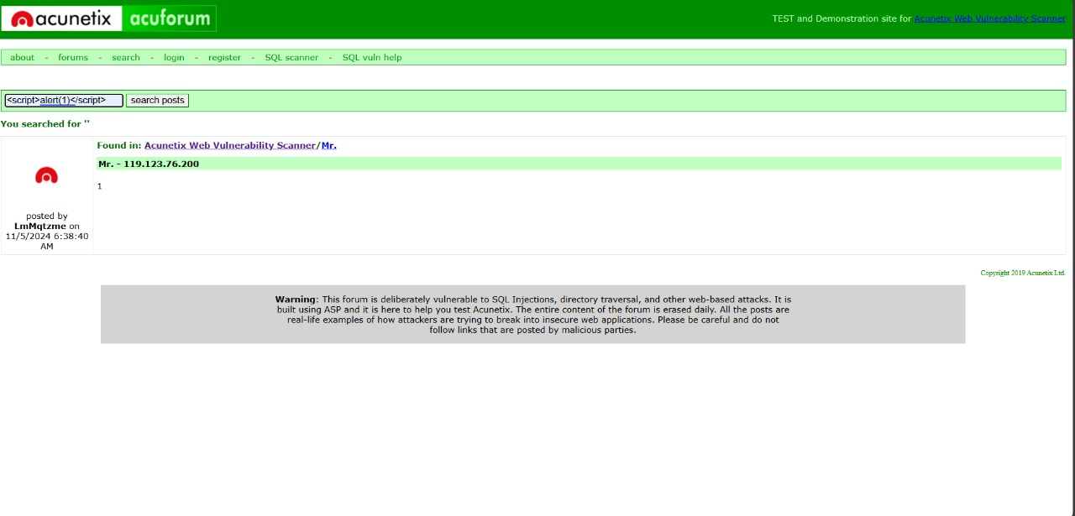
ENTER THE PAYLOAD OF XSS

Slide 9
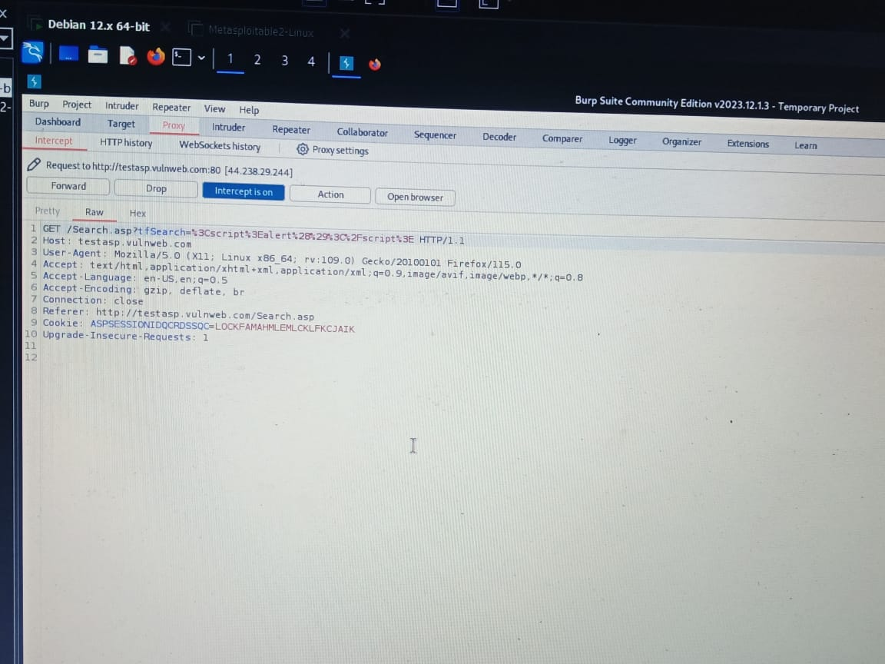
INTERCEPT THE REQUEST IN BURPSUITE

Slide 10
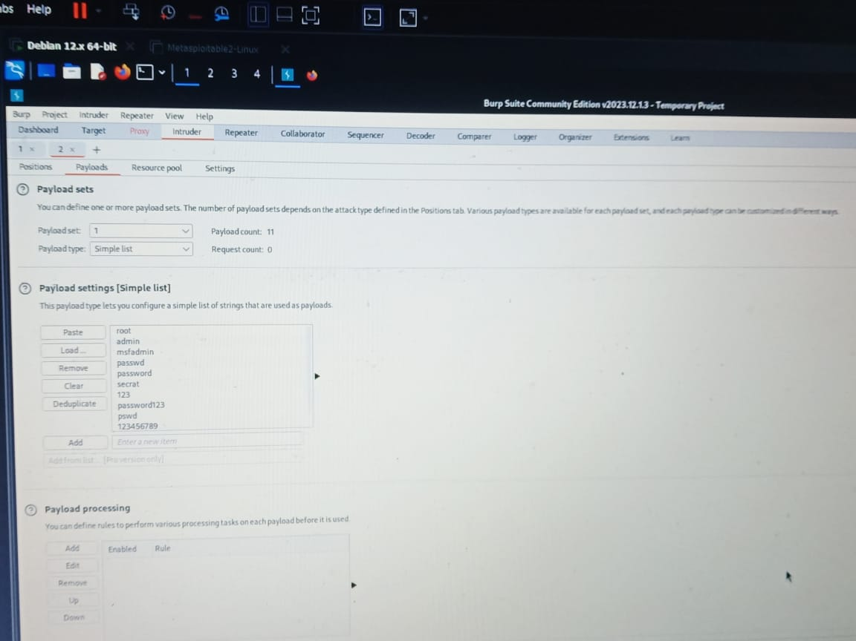
PASTING ALL PAYLOADS

Slide 11

CONCLUSION
In conclusion, Cross-Site Scripting (XSS) is a serious vulnerability that can compromise user data, damage trust, and even lead to significant financial and reputational losses. By understanding XSS risks and applying a layered approach to security—through input validation, output encoding, secure cookie practices, and implementing Content Security Policies—developers can protect web applications and their users from malicious attacks. Preventing XSS is a crucial part of modern web security, and with proactive coding practices and regular security audits, organizations can safeguard their applications and maintain user confidence.

